Slide 1
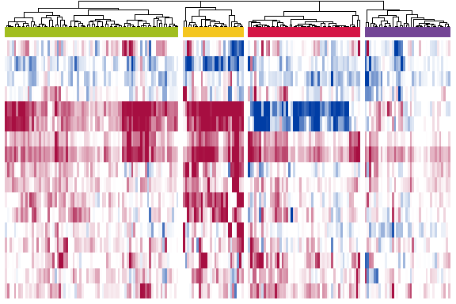
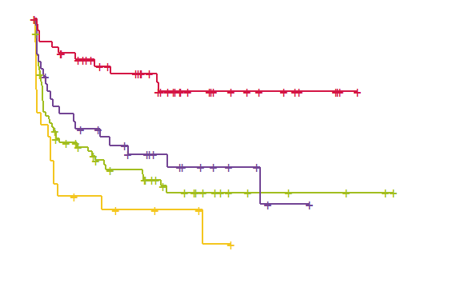

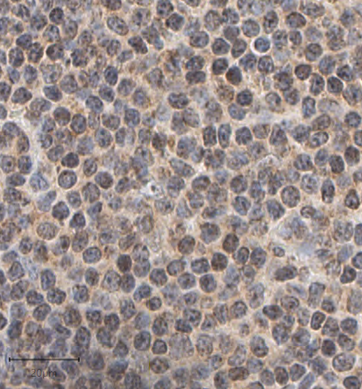
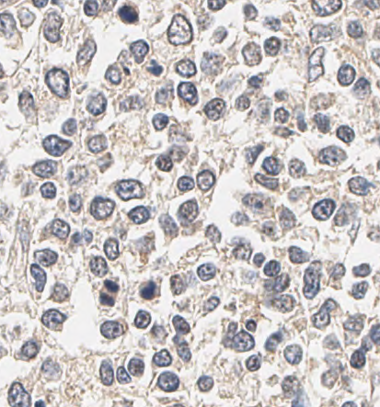
Microenvironmental response identifies CLL subgroups with distinct progression dynamics
Trisomy 12 epigenetic profile can be countered by bromodomain inhibition
IL4 activity is increased in CLL lymph nodes
CLL
Healthy

Slide 2
Combinatorial screening
Drugs
Stimuli
CLL cells
ex-vivo culture

